Slide 1
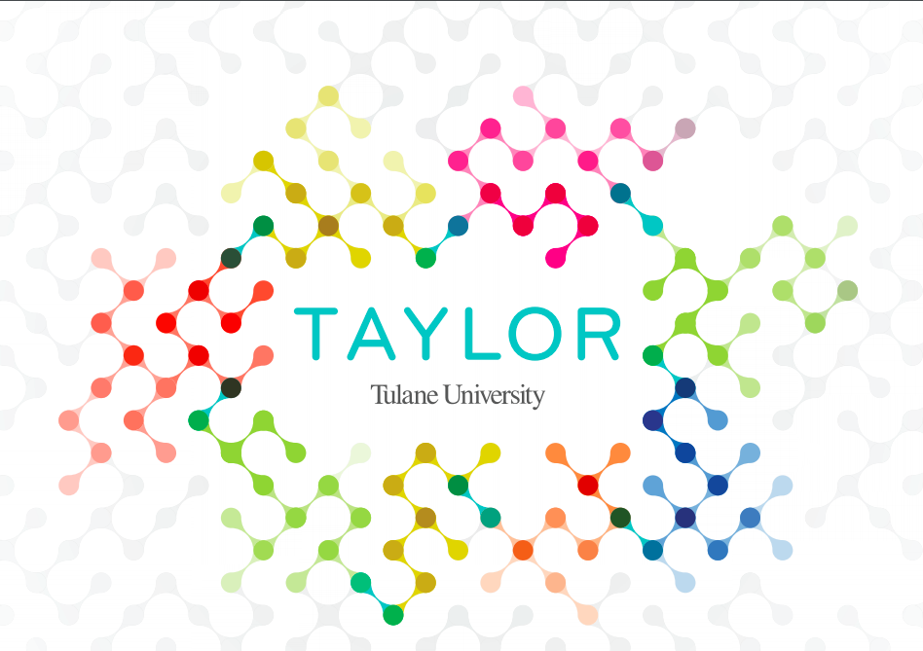


Slide 2


Tales from the Field:
A Social Innovation Conversation
With Jeanne Firth
and Maille Faughnan
September 12, 2018
Notes:
Presenter: MF/LLM will welcome everyone
-Background on SI conversations: Conversations in Social Innovation series engage young scholars, research partners, and knowledge enthusiasts in discussions about research efforts through Taylor and the community, in a casual round table setting. The conversations allow participants to connect their research with the pursuit of social innovations as well as new, effective, and system-aware solutions to persistent social problems. Taylor aims to promote networking, explore pathways in social innovation research, and advance our social innovation research collaborations among the center, Tulane, local universities, and community partners. We welcome doctoral students, faculty, post-doctoral researchers keen to learn more about research in social entrepreneurship, design thinking and social innovation.
TIMING: 15 mins total for Intro

Slide 3
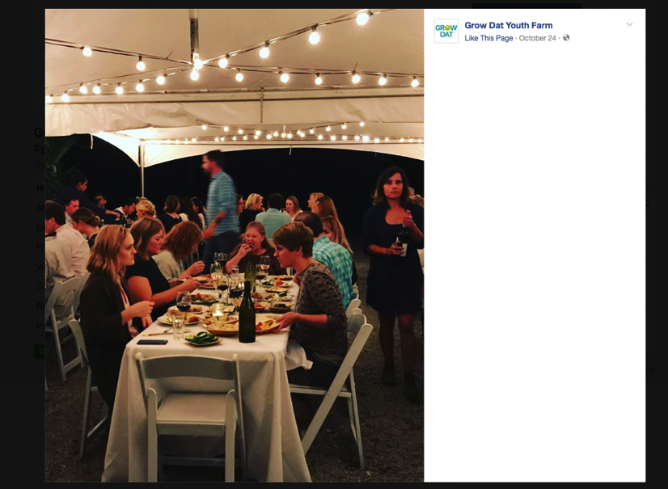
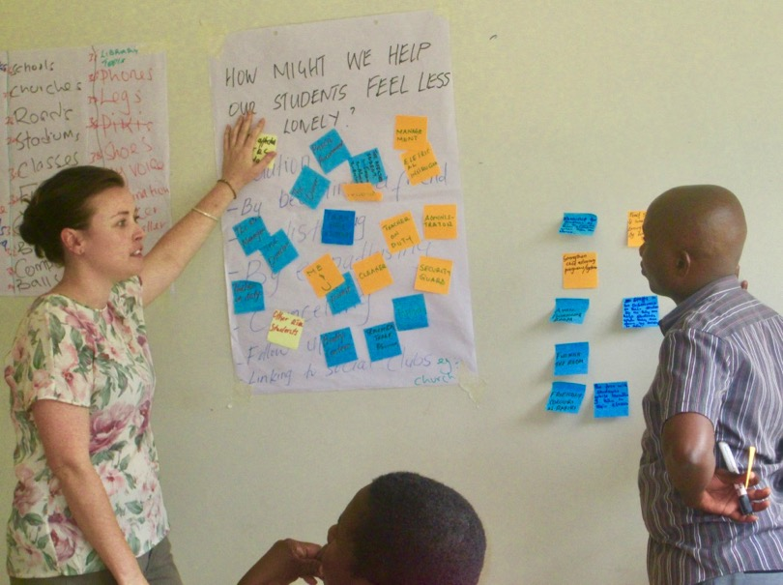
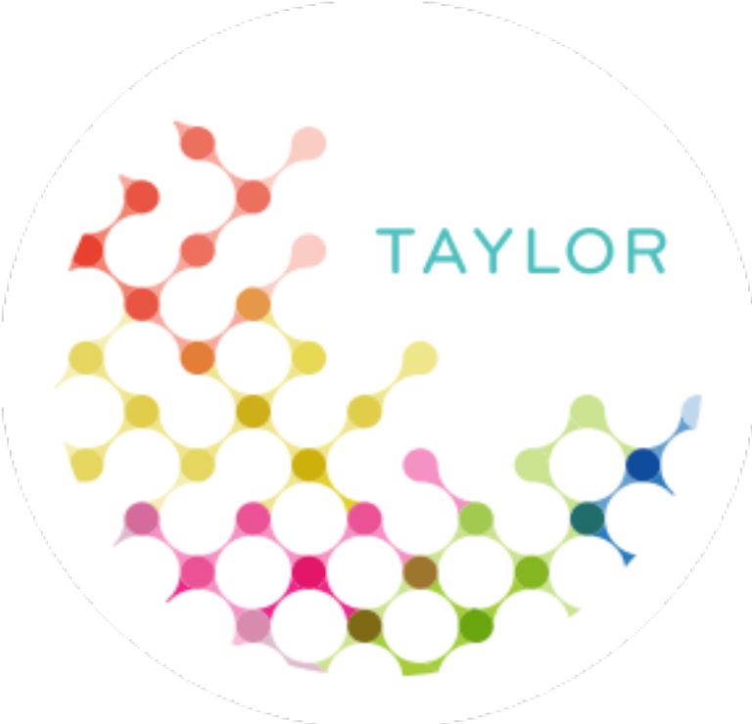
Who we are
Jeanne K Firth
Maille Faughnan
Notes:
TIMING: 3 Mins
Presenters: Both
Bios
MF: We’re here to talk about
Our use of ethnographically-grounded research on organizational life/institutional settings
Our exploration of the practices of actors and organizations working in food systems philanthropy and global aid, for community-level development
Some reflections on how social innovation lenses influence our work
We’ll each present a quick vignette from our research
Then we’ll share some reflections on each other’s work, and take some questions from the audience

Slide 4
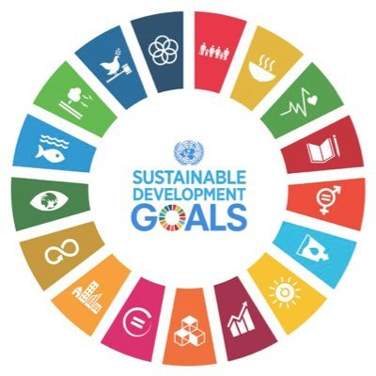
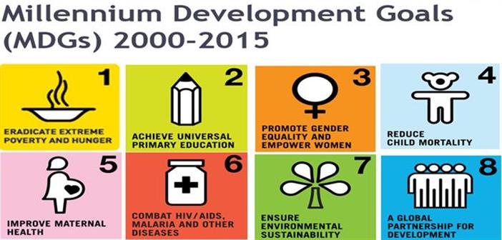
Framing: developmental configuration
Focus on actors, orgs & ideas circulating in developmentalist configuration (Olivier de Sardan, 2005)
Notes:
TIMING: 1 min
To-do:
find photo/fix slide text (if needed) – maybe SDGs?
Presenter?
We’d like to give you a little background to understand the framing of our studies
The bigger framing: looking at the practices of actors and organizations working in food systems philanthropy and global aid, for sustainable rural development
Aid industry/network is not a cohesive monolith, but we do acknowledge a developmentalist configuration of actors and social forms that are united as outsider efforts seeking to “[transform] a local milieu” (Olivier de Sardan, 2005, p. 38). This interventionist principle structures the work, and lives, of various actors.
We recognize some trends in informal and formal practices used to achieve this goal:
Operational/mgmt: theories of change, normative frameworks, management techniques like RBM, methodological tools, and philosophical approaches as well as everyday activities, behaviors, and forms of thought.
Policy agendas: good governance/economic growth environment; pro-poor development; MDGs → SDGs social entrepreneurship & innovation, participation,
→ these have to get implemented by someone
Common research problem is that:
Development actors’ and organizations’ practices, everyday operations and relationships impact aid effectiveness (Eyben, 2010; Olivier de Sardan, 2005; Mamman & Rees, 2007).

Slide 5
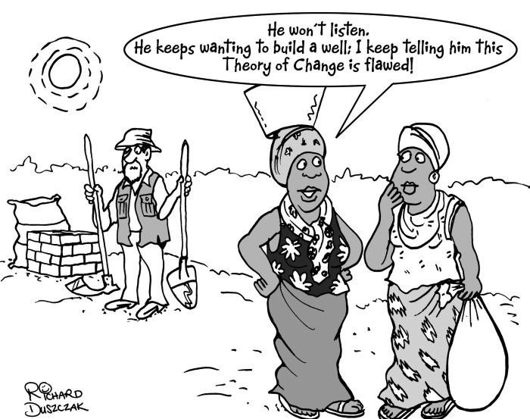
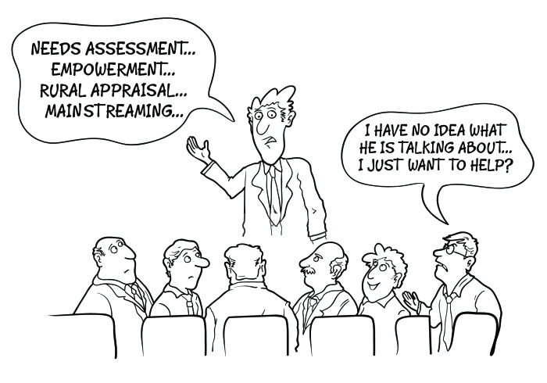
What’s wrong with development?
Source: Comic by Richard Duzczak, Cartoon Studio Ltd. http://www.cartoonstudio.co.uk
Notes:
TIMING: 1 min
Presenter: MF
MF: Evidence that development aid is working for economic growth or improved quality of life is at best inconclusive. Given the nearly $5 trillion given in foreign aid since WWII, results have been disappointing.
There are lots of critiques…some evident in the cartoon here:
Developers operate on rigid plan and pre-determined theory of change, and aren’t capable or willing to adapt; make some false assumptions about how change is really made, that reduce complexity to linear inputs and outputs.
Cultural biases and top-down decision-making structure of development -- there are broken feedback loops between supposed beneficiaries of aid and developers.
Networks/stakeholders: Vested interests in continuing status quo; diverse strategies & perspectives of different actors
Buzzwords and fuzzwords: Lots of new ideas about how development should be defined and practiced,
In the wake of “results-based management” and this new orgs are under pressure more than ever to demonstrate their effectiveness.
Often churning their practices, looking for the next big thing, which may be taken up in a symbolic or performative sense
Are we just superficially tweaking aid from time to time without addressing some of the fundamental structural problems like the balance of power?
But there are still many calls for more bottom-up, innovative and flexible, for “searchers”.
Makes the case for new, innovative processes for development but also presents some cautionary tales.

Slide 6





Who will end global poverty?
In the 1990s-2000s, public-private partnerships (PPPs) and ‘non-traditional’ development actors grew in the era of the ‘New Poverty Agenda’ or ‘New Policy Agenda’ (LaFleur and Brainard, 2009):
1. venture philanthropists
2. corporations
3. the poor
4. the public
5. celebrities
Notes:
TIMING: 1-2 mins
Presenter: JF?
Fluctuations in ODA, falling share to most impoverished?
Rise of NGOs, etc.

Slide 7
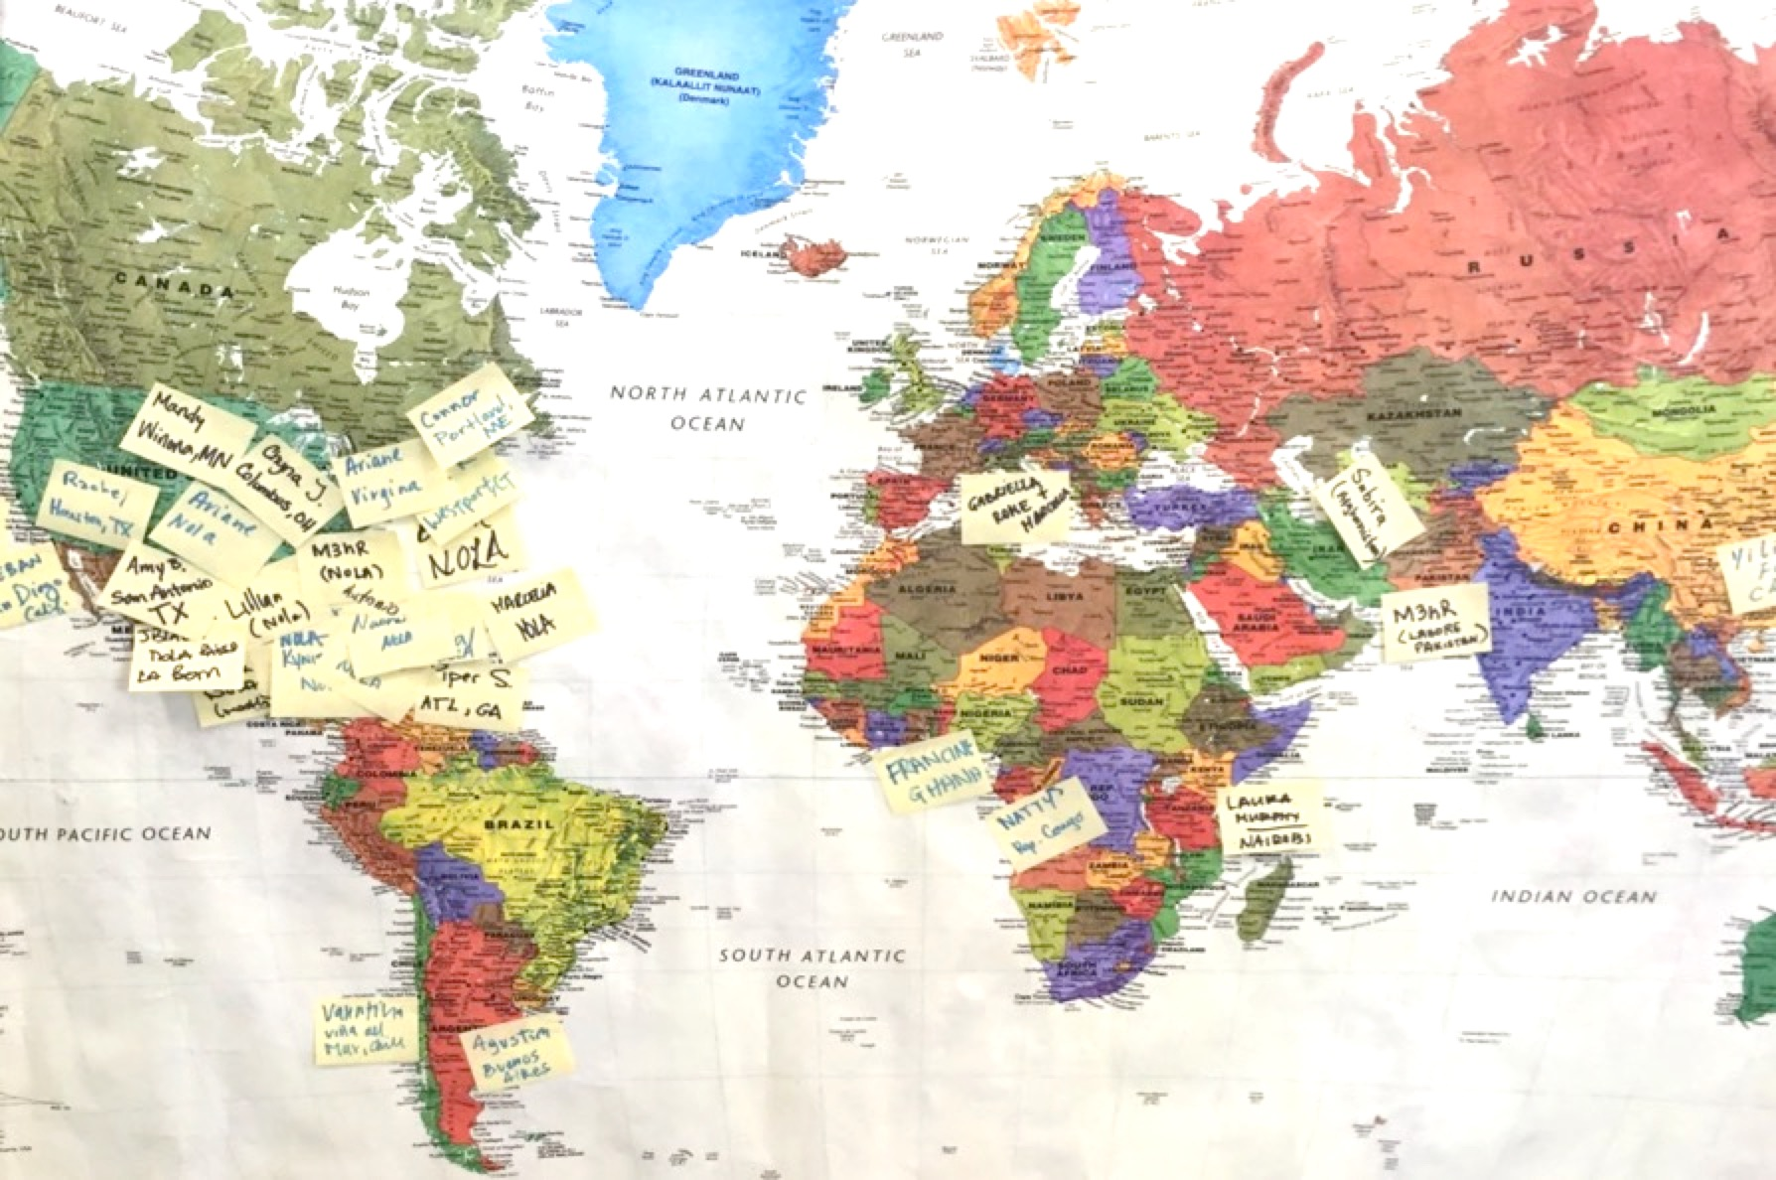
Design thinking in development
Design Thinking
Consulting
Partnerships
Funding
Labs
Social Enterprise
Integration
Capacity-Building
By MrJanzen1984 [CC BY-SA 4.0 (https://creativecommons.org/licenses/by-sa/4.0)], from Wikimedia Commons
Notes:
MF: 2 min: Background info on HCD, what it is, where it comes from, how it’s diffusing into development
Content: What I’m specifically looking at is this practice you might be familiar with – design thinking/HCD – I aim to understand what happens when it travels and is reproduced in an organizational setting.
Process:
This is a problem-solving strategy, borrowing practices of designers, , as processes for generating innovative solutions to meet end-user needs
Many different processes/frameworks – but some core principles are: empathy/human factors in design, reframing/defining problems, imagining new, out of the box ideas, developing prototypes and tangible ideas to push things faster through experimentation, testing ideas, refining—really about open-ended problem-solving processes
So, to clarify, it’s a process for innovation as well as an innovation in process, at least for the development field.
Popularity:
popularized by design firms like IDEO and higher education institutions like Stanford d.school
Champions/change agents taking expert design to social impact work, but they’re marketing the methodology to non-designers as well
People are excited about this: has become popular in private sector, making its way to public/citizen sectors, some take-up in development
the Gates Foundation, UNICEF, Grameen Bank, Concern Worldwide, Acumen Fund .
It’s spreading across the world in many ways – what I’m exploring in this research, the “capacity-building” model of spreading design thinking to a more diffuse development professional audience so that they can do it themselves -- through trainings, open-source materials and online courses – inline with a bottom-up, development strategy shifting decision-making power and best practices out of hands of....to everyone...democratizing
Design thinking is really being promoted to bring fresh ideas, creativity and empathy to development.
But, some challenges: goes against some traditional ways of doing development - it’s more iterative, adaptive, and open-ended problem solving. The challenges of capacity-building, and system readiness/fit

Slide 8
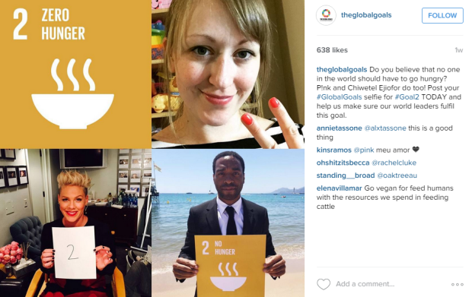
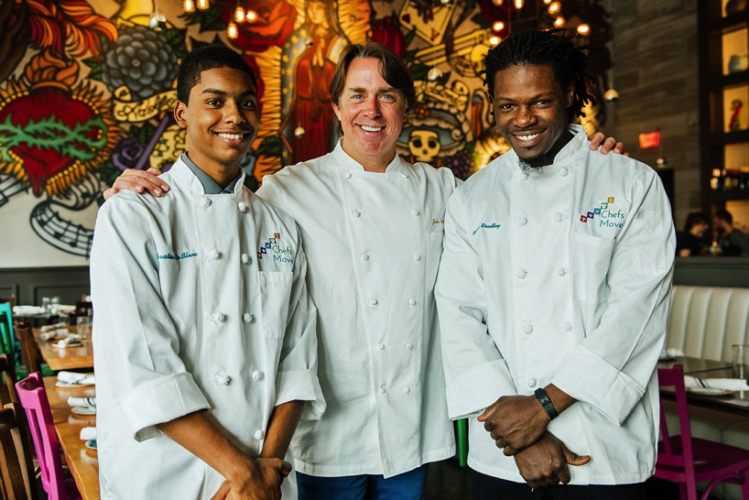
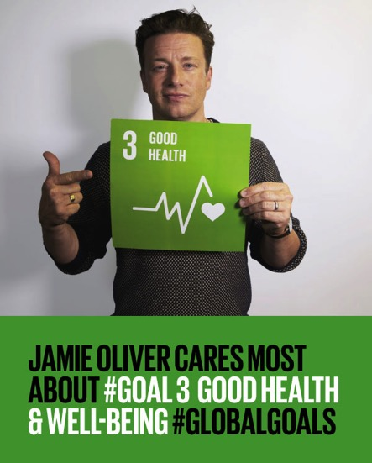
Solving global hunger & foodscape interventions
Notes:
1 min

Slide 9
Theoretical framework
The arena & agency
Diffusion of innovations
Research Question:
  How are development actors taking up DT, from dissemination processes, as a problem-solving strategy?
The Gift & Humanitarian Aid
Research Question:
What knowledges inform emergent elite philanthropic institutions and how are their efforts raced, classed and gendered in practice?
Notes:
TIMING: 4 mins
Presenter?
To do:
Slide text look ok?
What, if any, are the unifying frameworks of our work? Post-development critiques? Anthropology of Development? Do we need to mention those?
MF purposes:
The purpose is to describe and interpret, the encounter with a practice idea, DT, within a specific organizational setting affixed to a multi-layered socio-institutional space of development, through the eyes of development agents learning and adopting it
Exploratory study of how development actors embedded within a community development organization encounter and take up design thinking as a methodology for creative and empathetic problem-solving?
Reception/uptake at multiple levels (individual, group, organization)
How negotiations within the institutional setting (the arena) shape that manifestation

Slide 10
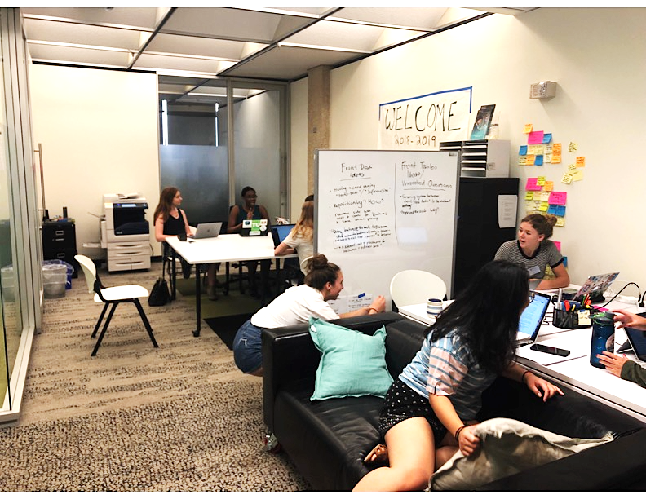
Ethnographic case design
Organizational Triangle by BenBeens CC-BY-2.5
Notes:
TIMING: 2 mins
Presenter: MF
Put emphasis on ethnography/case study
From this to this (left to right) triangle in development cooperation handbook;
Content (1 min)
This is an approach we share = analyzing ethnographic vignettes of ”critical incidents” from fieldwork, connecting our framing, theory and evidence
to show macro-micro interface happening in everyday life
Don't want the result on the left: the abstract, which I got when I put "organizational life" into the wiki commons search, but really illuminate the specific
The purpose of a vignette =
Miles, Huberman, & Saldana (2014):
Translates fieldwork into prose through a “focused description of a series of events taken to be representative, typical or emblematic in your case” (p. 182)
Usually pays attention to temporal, spatial, and interactive aspect of events
Offers an alternative to presenting data through categorical analysis that divorces your themes from meaning and context
“to heighten insight, illuminate and deepen understanding” and “enable vicarious experiencing” (P. 326)
Strengths of this type of approach for studying (processes of change, organizational practices, social dynamics of changemaking)
(I love some of these ideas from Ybema et al.’s Organizational Ethnography book: (if you haven’t downloaded it, you should, I found it open-source):
MF Background (30 seconds)
In something like a cross of action research, organizational ethnography and auto-ethnography, I did 2 rounds of DT training – 3 months each – during 2015 and 2016 in a community development organization in Western, rural Kenya
I conducted qualitative, immersive fieldwork on the processes and responses, to uptake (interviews w/intended adopters & stakeholders, participant observation, focus group discussions) - focusing on what they thought of training, how individuals and organization were making decisions about and incorporating DT into their work, what value they thought it had
JF Background

Slide 11
Injecting DT into the arena
“Can we do design thinking with the volunteers? How to have empathy, adjusting? They don’t understand how people can allow this in their communities. + [Staff] should know better than to lose their heads and agree to something like this. They can’t just let the volunteers run over them. They know we don’t do things this way.” – Director
“Things are crazy when they’re here. We’re running around like chickens. I’m worried about how much time we’ll have for design thinking.” – Mid-level leader & DT champion
The organization
Staff
Director
Guardians/OVCs
Volunteer donors
Interns
Consultants/Volunteers
Notes:
2 mins: Give you some background first
The setting:
Holistic community development organization
Working in a rural, agrarian village context
Mission: our mission is to empower communities and build their capacities to create positive change for children and youth within their community. category of OVCs and guardians,
All of these players in this story: foreign director, 50 some staff, interns, consultants and change agents, recurring european volunteers who are also donors
What: An account of events during 2015 trainings in which design thinking sessions bring together staff, interns and repeat European volunteers
first, second, or third training for some staff: early on
Vignette I'm going to share is an extended interaction: 2.5 weeks of training
Why: The purpose of highlighting this critical incident is to
probe the messy dynamics of uptake when DT is inserted into complicated organizational relationships
In which multiple objectives are unveiled or emerge, that I and many other players weren't privy to at the time (or ever)
DT is used to do something it’s not exactly intended to do
Now, I want to tell a story that begins with a request from the director while planning the training . She asked to do “design thinking” with returning volunteers – to help them process their cultural immersion experience. I know that there was an incident the year before – donors came across a house of a famiyl in disrepair, convince staff to rebuild it while dreictor is in nairobi, she's furious and someone gets fired – I think she really means "ethical community engagement" but I figure, we can do one empathy-building workhop, maybe a design workshop to show them a different way of sort of jumping to solutions

Slide 12
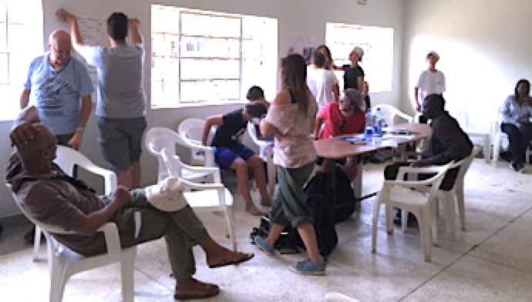
Negotiating objectives: DT for what…?
“We’re here to do work, we’re already doing it. You shouldn’t tell someone how to have their experience. If they want to make chapati, they’ll make chapati. You said we should immerse ourselves, but you’re trying to stop us by keeping us in here!”- Anna, Volunteer
“Training was so tiresome in the evening and we had the whole day's work. Maybe you haven't finished what you are doing, then it’s like: Get up, we’re going for design thinking! But I have this pending. This attitude I come with, I'm not ready to learn. My mind is not settled. Tomorrow, my boss will ask for my report.” – Sarah, Staff
“I want my staff to learn from the volunteers about how to communicate with Western donors, and I want volunteers to learn how things work here.” –Director
DT Overview
What/How/Why (photo)
Empathy Mindsets
Storytelling
Drawing
Affinity Mapping
Role-playing
Notes:
Planning processes –
I'm trying to translated director's wishes,
feel like I'm fighting for this workshop with volunteers,
staff are using the language of empathy and brainstorming in planning, responding to design thinking workshops but superficially
Lo and behold, the Friday before they arrive, I get an email with a schedule that shows I am leading design thinking workshops with the volunteers every afternoon from 4-5
First day – we do what/how/why and I suggest exercise for immersion and they revolt: "the work is out there, not in here, we're here to help!"
I give this feedback to management, kick it up to director, get the response that they're doubling down
Objective # 2 emerges: this is about exchange
So tuesday, a few more staff attend, we do these design research and analysis activities to help them process their day
By Wednesday – has become mandatory for staff, they're grumpy about it

Slide 13
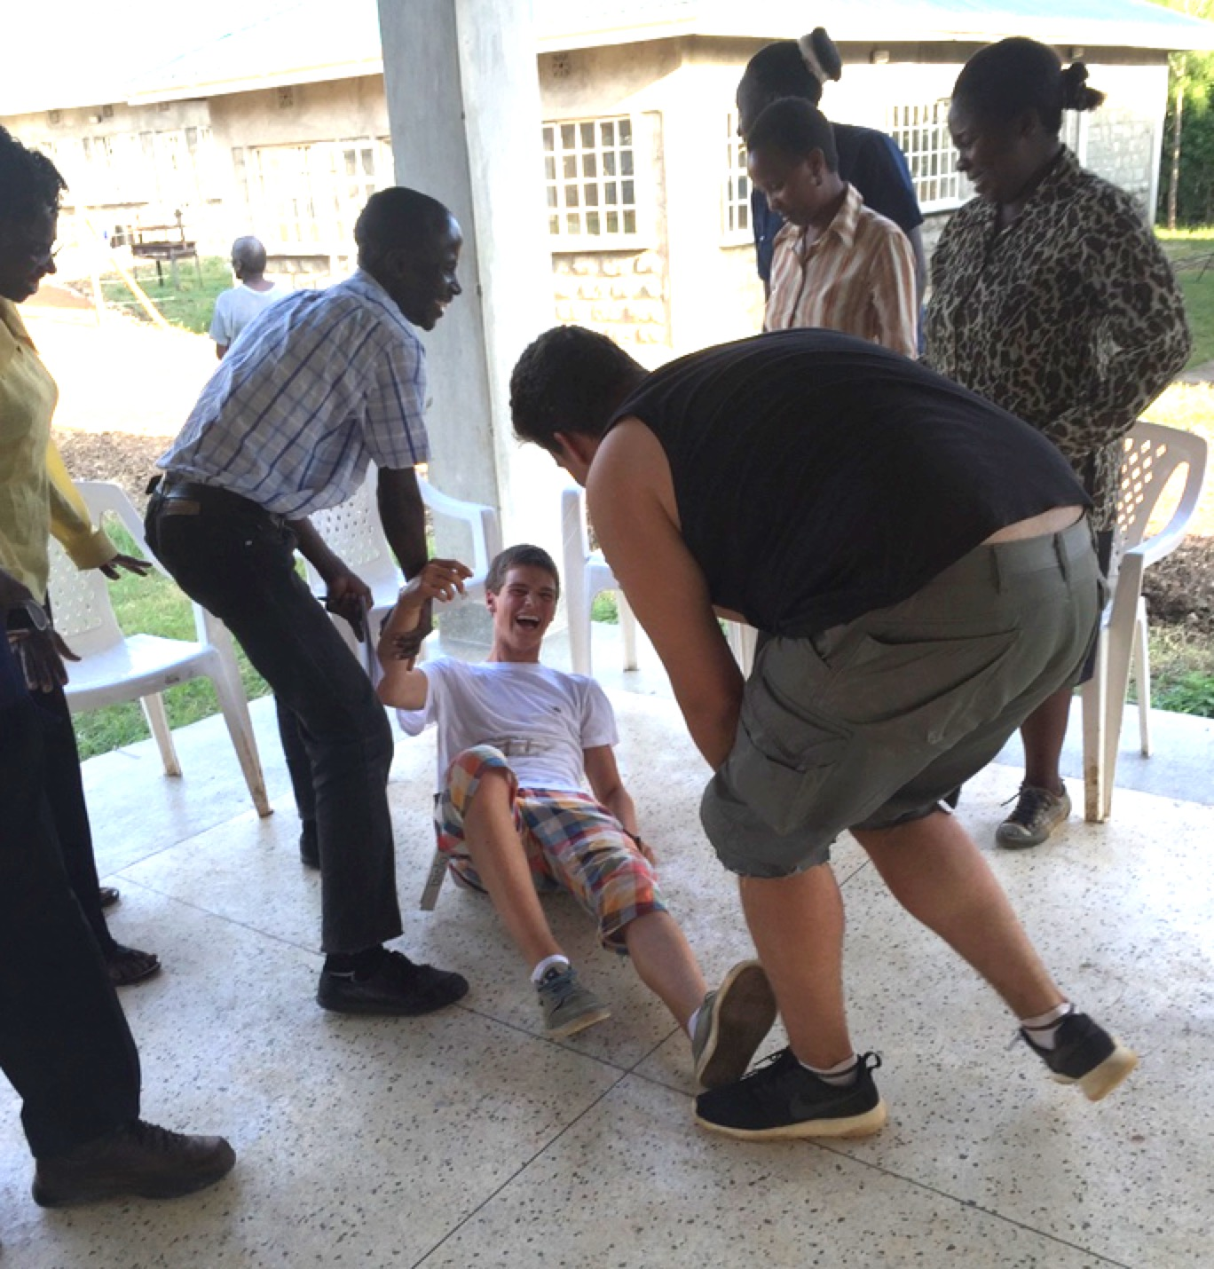
Turning points: interacting
“Less talking, more interacting” – Anna, Volunteer
“I still don’t understand why we have to be here. I don’t enjoy the sessions. We don’t think we should have to come back early.” – Irene, Volunteer
“People were most happy during the drawing bit.” – Staff Leader
“The session yesterday was better. They’re starting to come around to empathy and design thinking. We’re here to help, but we can also learn. It got emotional, and we realized how lucky we are. But you have to realize when you’re taking over as a facilitator, and step back.” – Volunteer Chaperone
“It’s not design thinking, but it’s based on my work training volunteer placements in South Africa. When you’re the giver, what is the dynamic for the recipients in a less powerful position? Let’s put all the feelings on the table about silent power issues and being beholden to others.” – Consultant
“I learned a lot and liked it. I could see people changing and thinking. We’re motivated and going to change lives, so we have to think about this interaction. Maybe an OVC here is happy because you gave them money, and they come back and help your kids. It’s about a cycle.” – Junior Staff
Notes:
Meanwhile – lunch
Director suggested monica step in
She suggests something
Leads exercise
Smash success
We keep doing it
Later on, staff report the favorite part of DT was the thing that wasn't DT

Slide 14
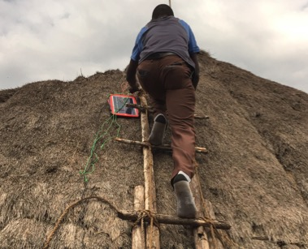
Converging: empathy & connection
“I want us to have actual empathy with people. We interact all the time, but we don’t really relate human to human. Maybe things are different than we thought. Maybe it’s not kids can’t read by kerosene, but the real problem is that parents don’t want to share light with the kids.” – Staff Organizer
“Everyone talked different, but in a few minutes, there was no language barrier. The [volunteers] didn’t know English, I didn’t know Luo, but we had to sing in Luo. It was fun. I got to learn from volunteers, and it was good embracing what the community is feeling and going through.” – Junior Staff
“It's like all the barriers just went down. We could all speak, and we had the opportunity to do it during the design thinking. That's something we discovered, all of us. At the last workshop, we didn’t speak a lot during this time, but the staff did. I think we reach a point that you are expecting at least. I liked that you didn’t make us any promises.” – Anna, Volunteer
“At the beginning, I didn’t like it. We wanted to be out doing the work. I don’t understand. But now I understand why we go and staff go, because they have to understand and to feel.” - Irene
“I think it was important to share with staff. We always started together, but not for all the important subjects. It was good for that.” -- Sofia
Notes:
Week 2:
Second objective: 130 household solar systems, supposed to install, they're not read, settle on 10
Idea of immersion – volunteers, staff go with them
DT champion/staff organizer
Do some processing activities in design to get feedback on the new systems, troubleshoot, come up with ways of installing the 120 systems better
Staff are happier

Slide 15
DT in the arena: conclusions
Knowledge & attitudes going in + different strategies aligning, orienting & emerging around DT (or not!)
  Staff/leader: limited understanding, managing donor relationships (keep 'em happy or out of my hair)
  Donors/volunteers trying to feel useful & helpful, don't see delicately being managed, uncritical perspective
  Recipients who are (outwardly) grateful and angling for fulfilling different needs
  Change agent w/dual mandate, trying to find design challenge
DT employed to
  Manage dynamics & relationships, facilitate exchange
  Troubleshoot predetermined solution, get buy-in
  DT ≠ process for innovative problem-solving/ = process for managing, enrolling, negotiating, “learning tool”
DT employed as
  Empathy mindset & methods
  Collaboration tools to exchange/connect perspectives
  Experimenting within given parameters
  Piecemeal: no problem to solve
Produces knowledge, attitudes, valuations
  Doesn’t really teach DT but succeeds in other ways
  Volunteers: hating it at first → empathy is good, we’re not designers but rethinking power dynamics
  Staff: DT = a burden , but valuable for “convening” & “connecting” → relational perspective
  Feedback loops: cements interpretations/ misunderstandings
Notes:
This vignette looking at process by which heterogenous actors, strategies, interpretations, levels of knowledge and power are meeting at this interface, and what new interpretations are produced. Actors are agents who carve out space for maneuvering, and they also learn from this encounter.
Really complicated dynamics in which actors are trying to. manage and respond to these events, so we've got all these different strategies
Leader/staff who don’t exactly understand DT
Leader trying to manage donor relations, foster trust/reciprocity/learning/exchange
Staff overburdened/fearful while navigating design thinking training period, trying to get donors out of their hair
Change agent with a dual mandate to teach DT and to “help” in general, and not sure how to communicate what should/shouldn’t do
Donors/volunteers trying to feel useful and helpful, unaware of how delicately they are being managed,
Recipients who are grateful, but who knows what they really wanted and are pushing for more
Over the interaction, DT employed to do many different things:
= No one shared objective across actors, and no one ”root” objective for each activity – so many things baked into this and DT showing up in different ways
DT about enabling interactions among different groups of the development arena, managing dynamics
and not for its traditional purpose: to develop innovative, user-centered ideas in response to an identified design challenge
Gets implemented as
empathy mindsets/methods
collaboration tools
experimentation within given parameters
to a pre-determined solution
Different responses among staff, volunteers, showing this is how it starts to get reinvented,
Their relational differences in power and perspective leads to negotiation of shared meanings, as well as fragmented interpretations of design thinking
But, and certain intentionalities baked in, shows up in certain ways
Calls into question its fitness for purpose,, but also ”successful” in some ways
Internal differences but some external cohesion + changes over the 2 weeks
Volunteers and staff who did not like DT at first did come to see a value in DT as a mode of interaction, which facilitated relationships and surfaced insights.
However, volunteers did not fully embrace the implications of DT for their own problem-solving practice by seeing themselves as designers. They were more comfortable seeing DT as a professional development tool for staff. Concepts of empathy, and co-learning with staff, seem to have aided a critical perspective shift. By setting aside their own interests for the sake of sessions with staff, volunteers were able to see the power dynamics inhabiting their relationship with the organization and act accordingly.
But staff continued to feel the burden of DT adding to their workload. As an encounter early in the case study timeframe, it likely shaped staff understanding of DT and its value. Their learning outcomes were not related to DT, but to these relationships of exchange.
These encounters serve as a feedback loop into understanding and attitudes towards DT (volunteers go away, but staff keep learning/applying in this setting)
I wanted to show you something different for those of us who are interested in the practical applications of teaching, using, incentivizing this work. As higher education institution, we might especially be thinking about teaching these tools in classroom or to others. But wanted to show what happens in a way that has implications for trying to bring this into a collective action scenario, into organizational spaces.

Slide 16
3 Minute Q&A

Slide 17
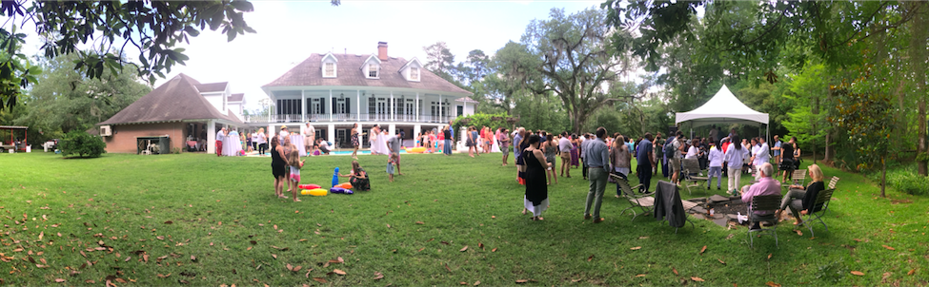
'A Delicious Excuse': Business-based knowledges and systems
Notes:
10 mins total

Slide 18
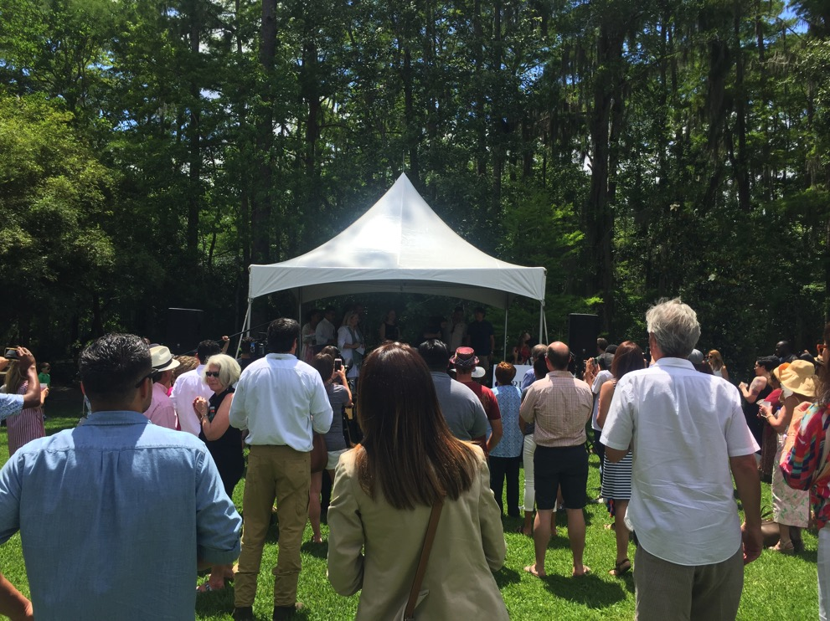
'A Delicious Excuse': Beneficiary Experience

Slide 19
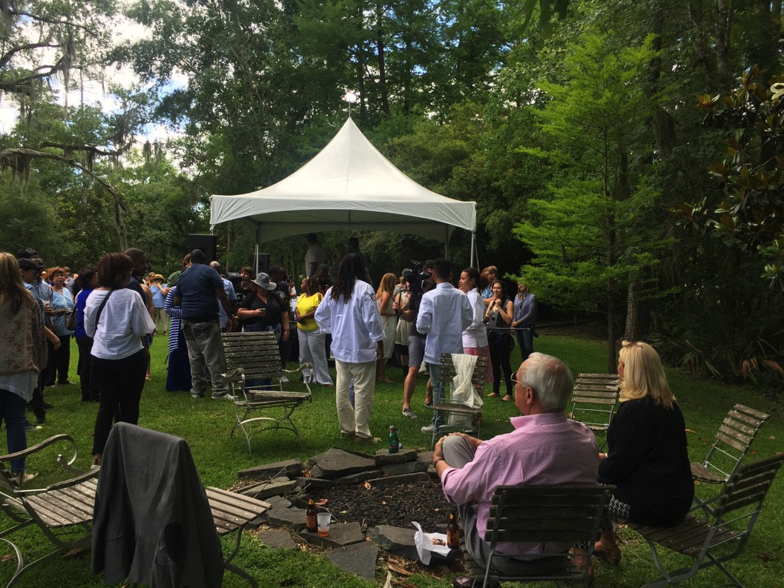
'A Delicious Excuse': Donor Experience

Slide 20
3 Minute Q&A

Slide 21
Food for thought…
Our reflections on each others work
Why is this a useful way to study change in complex systems?
Why do we think these processes are important to interrogate?
Is this social innovation research?
Notes:
TIMING: 10-15 mins for our conversation
Content:
We might say what we thought was interesting about each other’s work
Highlighting the methodology – why this is a useful way to study change in complex relationships and systems
Connections to social innovation – how does this field influence your thinking about the work? What makes this innovation?
E.g., Maille: SISE has made me attentive to process and practices, such as how we might deeply understand problems and systems, adapt to change, collaborate and relate to each other (as opposed to development industry views of participation or results focus)
E.g., Jeanne: work at GD farm dinners w/chef foundations, as an interesting experiment for GD to make $, earned-income streams
Maille could be helpful, using perspective from teaching class, to pointing out how and why social innovation might influence Jeanne’s work or provide a different lens
--> segue into
For Maille (these questions could be something thrown to audience, or for us to discuss)
How else might I interpret what I’m seeing? Other reasons/explanations for reinvention, for differential responses?
Is it misunderstanding/misuse or reinvention? Does that matter? Does it matter if it was “successful?”
What is it…a learning tool, a boundary object, an exchange technique, a negotiation process, social capital?
Those of you who know design thinking/are trying to use it, does this reflect your experience?
Reinvention or Misunderstanding?
Does it matter if it was ”successful”?

Slide 22
Food for thought…1-2-4-ALL
Is this social innovation research?
Are we studying social innovation processes?
Where do you see intersection with social innovation thinking? Your own discipline?
How could we look at our research problems and questions differently?
What do these findings tell us about potential for adopting innovative practices in social impact work?
Notes:
15 mins for our conversation
Examples:
Is this research on “social innovation”?
How could we look at our research questions/problems differently?
Something about findings themselves, like, what do these findings tell us about the potential for adopting innovative practices in social impact work/citizen sector?

Slide 23
References
Diprose, R. (2002). Corporeal Generosity: On Giving with Nietzsche, Merleau-Ponty, and Levinas. Albany: State University of New York Press.
LaFleur, V., & Brainard, L. (2009). ‘Making Poverty History? How Activists, Philanthropists, and the Public are Changing Global Development’. In L. Brainard & D. Chollet (Eds.), Global Development 2. 0: Can Philanthropists, the Public, and the Poor Make Poverty History? (pp. 9–41). Washington, D.C.: Brookings Institution Press.
Long, N. (2001). Development Sociology: Actor Perspectives. London: Routledge.
Olivier de Sardan, J.P. (2005). Anthropology and Development: Understanding Contemporary Social Change. The University of Chicago Press.
Organizational Triangle by BenBeens [CC-BY-2.5], from Wikimedia Commons.
Ybema, S., Yanow, D., Wels, H. & Kamsteeg, F. (2009). Organizational Ethnography: Studying the Complexities of Everyday Life. London: Sage Publications, Ltd.
Notes:
Flesh out

